Slide 1




GridWorld
© A+ Computer Science - www.apluscompsci.com

Slide 2
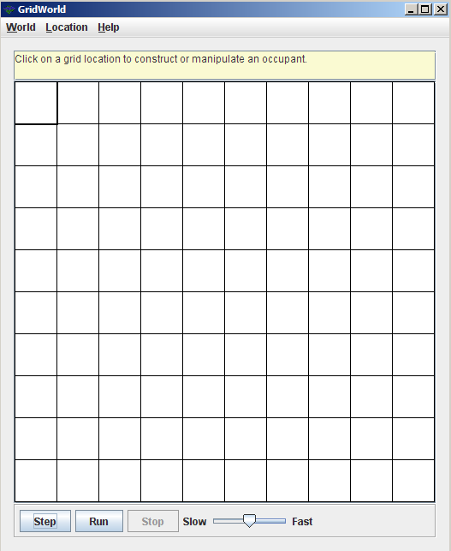
What is GridWorld?
Row = 0
Column = 0
© A+ Computer Science - www.apluscompsci.com
Notes:
A grid is a structure that has rows and columns.
A spreadsheet is a grid.
A checker board is a grid.

Slide 3
What is GridWorld?
cols
rows
A grid is a structure that has rows and columns.
© A+ Computer Science - www.apluscompsci.com
Notes:
A grid is a structure that has rows and columns.
A spreadsheet is a grid.
A checker board is a grid.

Slide 4
What is GridWorld?
Row = 2
Column = 1
© A+ Computer Science - www.apluscompsci.com
Notes:
A grid is a structure that has rows and columns.
A spreadsheet is a grid.
A checker board is a grid.

Slide 5
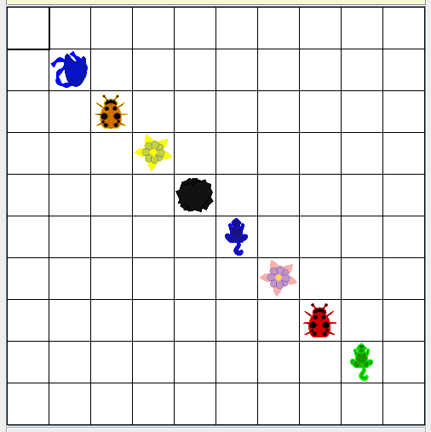
What is GridWorld?
© A+ Computer Science - www.apluscompsci.com

Slide 6
Grid
© A+ Computer Science - www.apluscompsci.com

Slide 7
Grid
Grid is an interface that details the
behaviors expected of a Grid.
Grid was designed as an interface because many different structures could be used to store the grid values.
An interface works perfectly due to the
large number of unknowns.
© A+ Computer Science - www.apluscompsci.com
Notes:
Grid is a row / column structure that stores Objects.
The location of each Object is determined by the Location provided when putting the Object in the grid.

Slide 8
Grid
A grid can store any type of Object.
Grid<Integer> intGrid;
intGrid = new BoundedGrid<Integer>(5,5);
Grid<String> stringGrid;
stringGrid = new UnboundedGrid<String>();
© A+ Computer Science - www.apluscompsci.com
Notes:
Grid is a row / column structure that stores Objects.
The location of each Object is determined by the Location provided when putting the Object in the grid.

Slide 9
Grid abstract methods
Name | Use
get(loc) | returns the ref at location loc
getEmptyAdjacentLocations(loc) | gets the valid empty locs in 8 dirs
getNeighbors(loc) | returns the objs around this
getNumCols() | gets the # of cols for this grid
getNumRows() | gets the # of rows for this grid
getOccupiedAdjacentLocations(loc) | gets the valid locs in 8 dirs that contain objs
getOccupiedLocations() | gets locs that contain live objs
getValidAdjacentLocations(loc) | gets the valid locs in 8 dirs
isValid(loc) | checks to see if loc is valid
put(loc, obj) | put the obj in grid at location loc
remove(loc) | take the obj at location loc out of the grid
import info.gridworld.grid.Grid;
© A+ Computer Science - www.apluscompsci.com

Slide 10
Grid
rows
0 | 0 | 0 | 0 | 0
0 | 0 | 0 | 0 | 0
0 | 0 | 0 | 0 | 0
0 | 0 | 0 | 0 | 0
0 | 0 | 0 | 0 | 0
rows
A grid is a structure that has rows and columns.
© A+ Computer Science - www.apluscompsci.com
Notes:
A grid is a structure that has rows and columns.
A spreadsheet is a grid.
A checker board is a grid.

Slide 11
Grid
cols
cols
0 | 0 | 0 | 0 | 0
0 | 0 | 0 | 0 | 0
0 | 0 | 0 | 0 | 0
0 | 0 | 0 | 0 | 0
0 | 0 | 0 | 0 | 0
A grid is a structure that has rows and columns.
© A+ Computer Science - www.apluscompsci.com
Notes:
A grid is a structure that has rows and columns.
A spreadsheet is a grid.
A checker board is a grid.

Slide 12
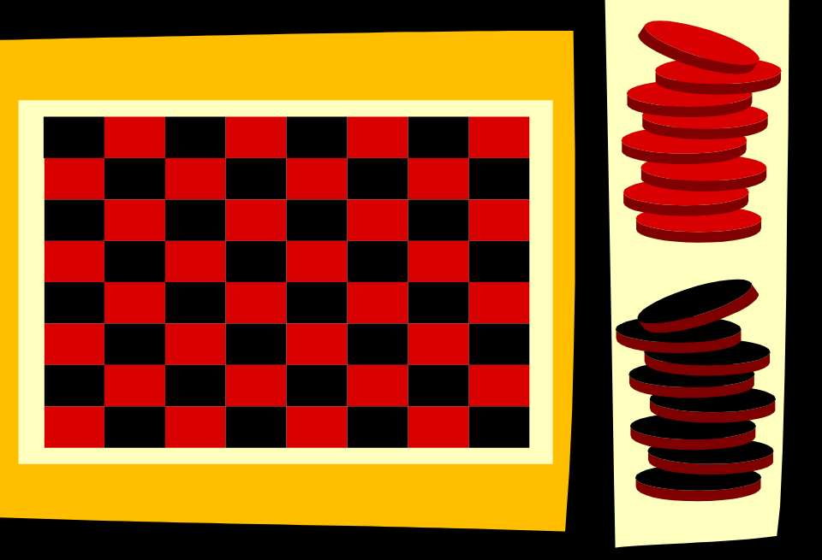
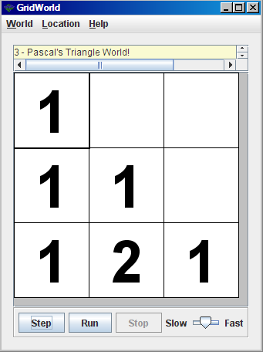
Grid
A grid is a structure that has rows and columns.
© A+ Computer Science - www.apluscompsci.com
Notes:
A grid is a structure that has rows and columns.
A spreadsheet is a grid.
A checker board is a grid.

Slide 13
AbstractGrid
© A+ Computer Science - www.apluscompsci.com

Slide 14
AbstractGrid
AbstractGrid is an abstract class that
implements five of the Grid interface
methods that would be common to any
type of grid implementation.
AbstractGrid works best as an abstract class
as there are some things known and some
things that are still unknown.
© A+ Computer Science - www.apluscompsci.com
Notes:
AbstractGrid implements the methods from the Grid interfaces that will be the same for all types of grids.
There are five methods that will be the same no matter what type of data structure is used to store grid elements.

Slide 15
AbstractGrid implements Grid frequently used methods
Name | Use
getNeighbors(loc) | returns the objs around this
getValidAdjacentLocations(loc) | gets the valid locs in 8 dirs
getEmptyAdjacentLocations(loc) | gets the valid empty locs in 8 dirs
getOccupiedAdjacentLocations() | gets adjacent locs that contain live objs
toString() | returns a list of the stuff in the grid
import info.gridworld.grid.AbstractGrid;
© A+ Computer Science - www.apluscompsci.com

Slide 16
BoundedGrid
© A+ Computer Science - www.apluscompsci.com

Slide 17
BoundedGrid
BoundedGrid extends AbstractGrid and implements the remaining Grid interface methods.
BoundedGrid stores everything in a matrix.
Object[][] occupantArray;
© A+ Computer Science - www.apluscompsci.com
Notes:
BoundedGrid implements the remaining Grid methods that AbstractGrid did not implement.
BoundedGrid uses a matrix to store all object references.

Slide 18
BoundedGrid extends AbstractGrid frequently used methods
Name | Use
BoundedGrid(rows, cols) | creates a new Grid[rows,cols]
getNumCols() | gets the # of cols for this grid
getNumRows() | gets the # of rows for this grid
import info.gridworld.grid.BoundedGrid;
BoundedGrid is a matrix of object references.
© A+ Computer Science - www.apluscompsci.com

Slide 19
BoundedGrid
BoundedGrid<Integer> grid;
grid = new BoundedGrid<Integer>(5,5);
System.out.println(grid.getNumRows());
System.out.println(grid.getNumCols());
System.out.println(grid);
OUTPUT
5
5
{}
© A+ Computer Science - www.apluscompsci.com
Notes:
BoundedGrid is a grid that has a set number of rows and columns.
BoundedGrid has a limited number of storage locations.

Slide 20
open
bgridone.java
© A+ Computer Science - www.apluscompsci.com

Slide 21
BoundedGrid extends AbstractGrid frequently used methods
Name | Use
isValid(location) | checks if location is inside of the grid
get(location) | gets the Object at specified location
getOccupiedLocations() | returns a list of occupied locs
put(location, thang) | put thang at spot location
remove(location) | removes thang at spot location
import info.gridworld.grid.BoundedGrid;
© A+ Computer Science - www.apluscompsci.com

Slide 22
BoundedGrid
BoundedGrid<Integer> grid;
grid = new BoundedGrid<Integer>(5,5);
grid.put(new Location(2,2),4);
grid.put(new Location(1,1),11);
System.out.println(grid);
System.out.println(grid.isValid(new Location(-2,3)));
System.out.println(grid.isValid(new Location(2,3)));
OUTPUT
{(1, 1)=11, (2, 2)=4}
false
true
 | 11
 |  | 4
© A+ Computer Science - www.apluscompsci.com
Notes:
BoundedGrid is a grid that has a set number of rows and columns.
BoundedGrid has a limited number of storage locations.
BoundedGrid has a top left storage location of (0,0).
BoundedGrid has a bottom right storage location of (length-1,length-1).
The isValid method will determine if a provided location is within the bounds of the provided grid.

Slide 23
BoundedGrid
BoundedGrid<Integer> grid;
grid = new BoundedGrid<Integer>(5,5);
//add 4 at 2,2 - add 11 at 1,1 - add 3 at 0,2 - add 6 at 0,1
System.out.println(grid);
grid.remove(new Location(1,1));
System.out.println(grid);
grid.remove(new Location(1,1));
System.out.println(grid);
OUTPUT
{(0, 1)=6, (0, 2)=3, (1, 1)=11, (2, 2)=4}
{(0, 1)=6, (0, 2)=3, (2, 2)=4}
{(0, 1)=6, (0, 2)=3, (2, 2)=4}
© A+ Computer Science - www.apluscompsci.com
Notes:
When a grid is printed, each location that has a value is shown and the value stored in that location is also shown.

Slide 24
open
bgridtwo.java
bgridthree.java
© A+ Computer Science - www.apluscompsci.com

Slide 25
UnboundedGrid
© A+ Computer Science - www.apluscompsci.com

Slide 26
UnboundedGrid
UnboundedGrid extends AbstractGrid and implements the remaining Grid interface methods.
UnboundedGrid stores locations and references in a Map.
Map<Location, E> occupantMap;
© A+ Computer Science - www.apluscompsci.com
Notes:
The UnboundedGrid example provided with GridWorld uses a map to store all object references.
A map is not the only data structure that could be used to store an unlimited number of objects.

Slide 27
UnboundedGrid extends AbstractGrid frequently used methods
Name | Use
UnboundedGrid() | creates an empty grid
getNumCols() | returns -1
getNumRows() | returns -1
import info.gridworld.grid.UnboundedGrid;
UnboundedGrid stores loc and objs in a Map.
© A+ Computer Science - www.apluscompsci.com

Slide 28
UnboundedGrid
UnboundedGrid<Integer> grid;
grid = new UnboundedGrid<Integer>();
System.out.println(grid.getNumRows());
System.out.println(grid.getNumCols());
System.out.println(grid);
OUTPUT
-1
-1
{}
© A+ Computer Science - www.apluscompsci.com
Notes:
UnboundedGrid is a grid that does not have a set number of rows and columns.
UnboundedGrid has an unlimited number of storage locations.

Slide 29
open
ubgridone.java
© A+ Computer Science - www.apluscompsci.com

Slide 30
UnboundedGrid extends AbstractGrid frequently used methods
Name | Use
isValid(location) | checks if location is inside of the grid
get(location) | gets the Object at specified location
getOccupiedLocations() | returns a list of occupied locs
put(location, thang) | put thang at spot location
remove(location) | removes thang at spot location
import info.gridworld.grid.UnboundedGrid;
© A+ Computer Science - www.apluscompsci.com

Slide 31
UnboundedGrid
UnboundedGrid<Integer> grid;
grid = new UnboundedGrid<Integer>();
grid.put(new Location(2,2),4);
grid.put(new Location(1,1),11);
System.out.println(grid);
System.out.println(grid.isValid(new Location(-2,3)));
System.out.println(grid.isValid(new Location(2,3)));
OUTPUT
{(1, 1)=11, (2, 2)=4}
true
true
 | 11
 |  | 4
© A+ Computer Science - www.apluscompsci.com
Notes:
UnboundedGrid is a grid that does not have a set number of rows and columns.
UnboundedGrid has an unlimited number of storage locations.
UnboundedGrid has no set top left storage location.
UnboundedGrid has no set bottom right storage location.
The isValid method will determine if a provided location is within the bounds of the provided grid.
All locations are valid for an unbounded grid.

Slide 32
UnboundedGrid
UnboundedGrid<Integer> grid;
grid = new UnboundedGrid<Integer>();
//add 4 at 2,2 - add 11 at 1,1 - add 3 at 0,2 - add 6 at 0,1
System.out.println(grid);
grid.remove(new Location(1,1));
System.out.println(grid);
grid.remove(new Location(1,1));
System.out.println(grid);
OUTPUT
{(0, 1)=6, (0, 2)=3, (1, 1)=11, (2, 2)=4}
{(0, 1)=6, (0, 2)=3, (2, 2)=4}
{(0, 1)=6, (0, 2)=3, (2, 2)=4}
© A+ Computer Science - www.apluscompsci.com
Notes:
When a grid is printed, each location that has a value is shown and the value stored in that location is also shown.

Slide 33
open
ubgridtwo.java
ubgridthree.java
© A+ Computer Science - www.apluscompsci.com

Slide 34
World
© A+ Computer Science - www.apluscompsci.com

Slide 35
World frequently used methods
Name | Use
World() | creates a new world using 10X10 grid
World(grid) | creates a new world using grid
add(loc, thang) | add thang at spot loc
show() | makes the world visible
import info.gridworld.world.World;
© A+ Computer Science - www.apluscompsci.com

Slide 36
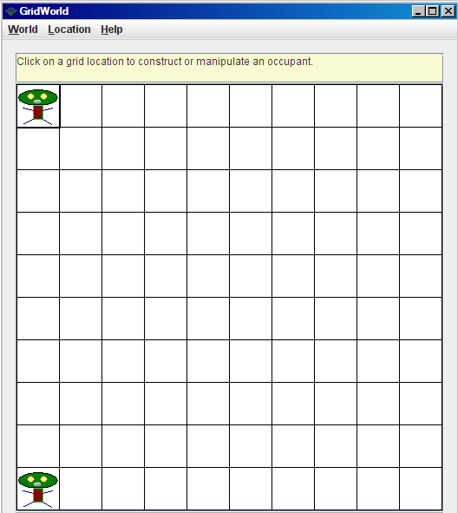
World
World<Monster> world = new World<Monster>();
world.add(new Location(0,0), new Monster());
world.add(new Location(9,0), new Monster());
world.show();
© A+ Computer Science - www.apluscompsci.com
Notes:
World is used to house a Grid. World is used to display the Grid graphically.

Slide 37
open
worldone.java
© A+ Computer Science - www.apluscompsci.com

Slide 38
World frequently used methods
Name | Use
getGrid() | returns a ref to the world’s grid
remove(location) | removes the thang at location
locationClicked(loc) | activated by a mouse click in the grid
import info.gridworld.world.World;
© A+ Computer Science - www.apluscompsci.com

Slide 39
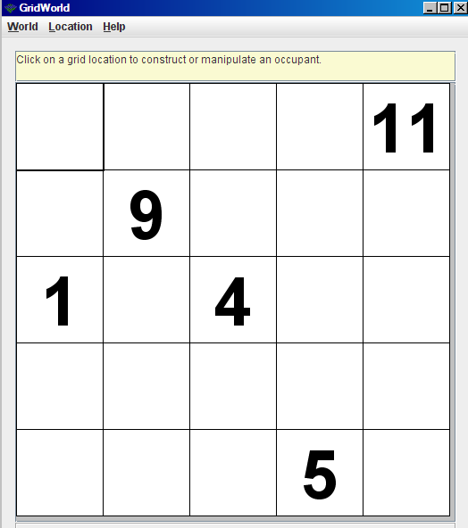
World
BoundedGrid<Integer> grid;
grid = new BoundedGrid<Integer>(5,5);
grid.put(new Location(2,2),4);
grid.put(new Location(1,1),9);
grid.put(new Location(0,4),11);
grid.put(new Location(4,3),5);
grid.put(new Location(2,0),1);
World<Integer> world;
world = new World<Integer>(grid);
world.show();
© A+ Computer Science - www.apluscompsci.com
Notes:
World is used to house a Grid. World is used to display the Grid graphically.

Slide 40
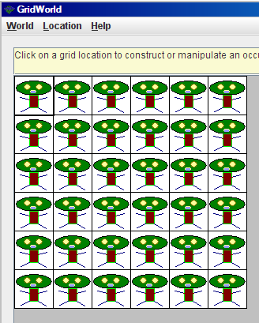
World
World<Monster> world;
world = new World<Monster>(new BoundedGrid(6,6));
world.show();
Grid<Monster> grid = world.getGrid();
for(int r=0; r<grid.getNumRows(); r++)
{
for(int c=0; c<grid.getNumCols(); c++)
{
grid.put(new Location(r,c),
new Monster(r,c,2));
}
}
© A+ Computer Science - www.apluscompsci.com
Notes:
World is used to house a Grid. World is used to display the Grid graphically.

Slide 41
open
worldtwo.java
worldthree.java
© A+ Computer Science - www.apluscompsci.com

Slide 42
Start work
on Grid Labs
© A+ Computer Science - www.apluscompsci.com

